Slide 1


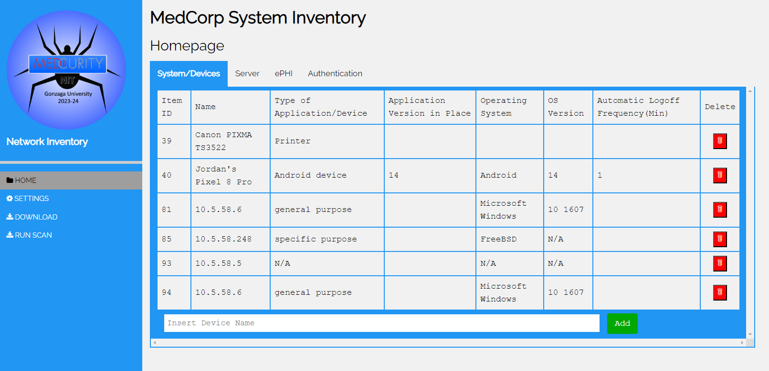

CS10: Device & Software Inventory Tool
Brandon Huyck, Colleen Lemak, Artis Nateephaisan, Jack Nealon
Medcurity, Gonzaga University
Abstract
Project Components
Conclusions
In our modern age, companies are valuable targets for digital security breaches and malicious attacks. This is especially pertinent for companies that need to adhere to medical record compliance standards to protect sensitive patient health information. The mission of our sponsor, Medcurity, is to ensure that companies handle such data with care and mitigate its risk of being exploited by attackers.
Our tool assists in that mission by scanning the networks of Medcurity’s clients and automating the compilation of an inventory of software and devices connected to it. The tool will crawl the client’s network and add the information discovered to our database. This information is then displayed to the client through a UI that lets them update and insert incorrectly gathered and missing information. After review, they can export the data to a spreadsheet for ease of access.
Crawler
User Interface
Future Development
Uses a Python3 script backend
Executes Nmap and ARP scans to retrieve device and software data
Collects operating system name, version, device type, server location, ports and their statuses, among other attributes
Stores crawled data in remote database
Launched on button-click in the user-interface
Each client has a manager for user-account management
Editable cells on the user-interface’s Server page
User-interface filtering
Configuration of network page
Relevant status messages and progress bars
Manually input IP range to scan
Further administrator privileges
Combination of HTML, PHP, SQL, JavaScript, and Python Languages
Database
Additional Components
Takeaways
Uses a MariaDB Amazon Web Services (AWS) Relational Database Server (RDS)
Uses the industry standard AES-256 algorithm to securely encrypt the data on the server that hosts the database
Stores devices as well as users
Relations created based on list of attributes provided by sponsor
Relations are normalized, and data is validated before being inputted
Created a Python module containing a custom API for use by the Crawler and CSV Export scripts
Connects to the front-end using PHP to display the data
CSV Report:
Generating a CSV report from the database was a sponsor requirement
Generate an admin or client report based on logged in user
Written as a Python script and uses the database API library to access the table and return a list of all inventory items, writing them to the csv file
Testing:
Crawler was tested on a safe testing network using a variety of devices
Documentation:
Developers wrote and consistently updated documentation that details project components, instructions, set up process, and other notable details
In summary, we developed a network inventory tool that…
Scans a network
Identifies devices that are connected on a given network
Stores scanned network device information into a secure database
Displays the data in a user-friendly interface where only approved Medcurity admins and their client users are able to access
Allows users to make changes to rows of the found devices, where changes are updated in real-time, ensuring that the information displayed is accurate
Lets users export the data from the table into a CSV report
Student Developer Team
Colleen, Artis, Brandon, Jack

